Slide 1
Intro to Data Structures
For Non-Programmers/ Python Beginners
Pamela Pan, Data Services Fellow
shanghai.library.data@nyu.edu
Fall 2021
NYU Shanghai Library

Slide 2
Welcome to the
second workshop
in the Python Series!
1. Intro to Python
Comments, Variables, Operators, and Statements
2. Intro to Data Structures
Lists, Tuples, Sets and Dictionaries; Iterations and Functions
3. Intro to Data Analysis
with Python
Basic exploratory data analysis
Notes:
Sharing Link
Download link
More about workshops

Slide 3
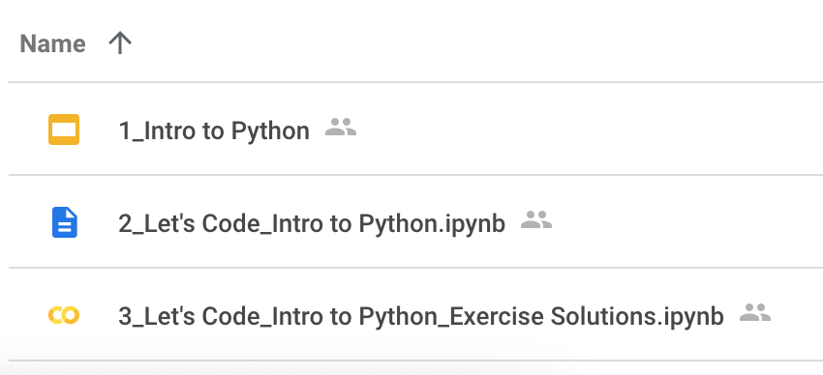
Workshop I Recap (Part I: Slides)
What is Python
Why Python
A simple syntax similar to the English language.
Same task, fewer lines of code than other languages.
Uses of Python
Python vs. R
R is mainly used for statistical analysis while Python provides a more general approach to data science
Python Environment
Terminal, Integrated Development Environment (IDE), Interactive Computational Environment (ICE)
Where it is in the Workshop I drive

Slide 4
Workshop I Recap (Part II: Code)
Comments
#
Variables
Numbers
Booleans
Strings
Operators
Arithmetic (+-*/)
Assignment (=, -=, +=)
Comparison (==)
Logical (> <)
Identity (is)
Membership (in/ not in)
Statements
If … Elif … Else ...
And
Or
Where it is in the Workshop I drive

Slide 5
Got errors? Programmers be like...
StackOverflow
CSDN (Chinese)
Notes:
You don’t have to memorize all of the concepts and rules (it’s almost impossible unless you’re an absolute guru in Python and use it every day)
If you hit an error but don’t know what it means, it’s absolutely normal to Google it!

Slide 6
Let’s code!
Link to the workshop notebook:
Download here

Slide 7
Further Study Resources
The official website of Python: https://www.python.org/
Python for Everybody: https://www.py4e.com/lessons
W3 Schools: https://www.w3schools.com/python/default.asp
freeCodeCamp: https://www.freecodecamp.org/learn/scientific-computing-with-python/

Slide 8

Thank you!
Contact: shanghai.library.data@nyu.edu
Data Services @ NYU Shanghai Library
Other workshop resources:
👉 https://nyu-shanghai-data-services.github.io/resources/
Feedback form
tinyurl.com/libworkshopfeedback

